Slide 1

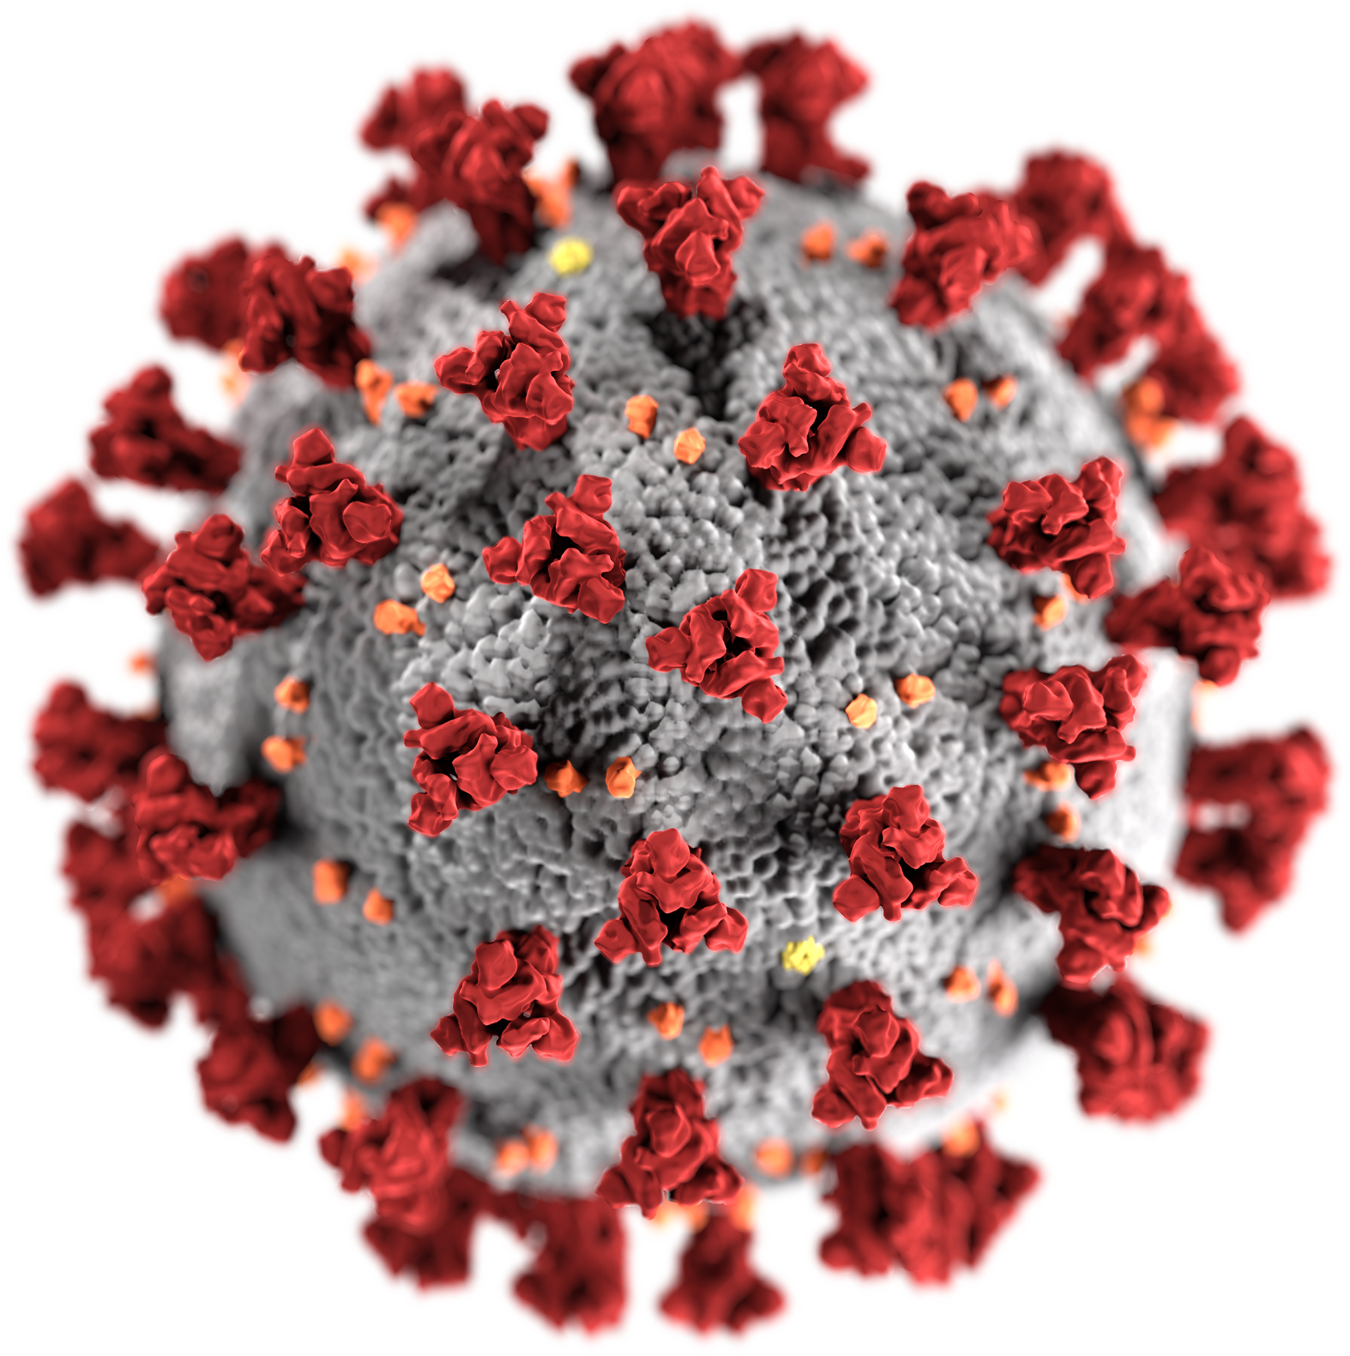
Week 1:
Brief description of scientific papers related to modeling the corona outbreak
Group: Quentin Quarantino

Slide 2
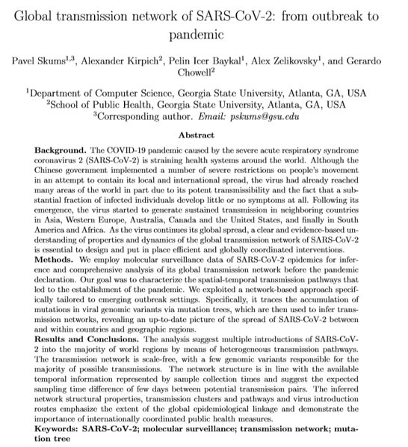
Jounal
Preprint
Published
March 27, 2020

Slide 3
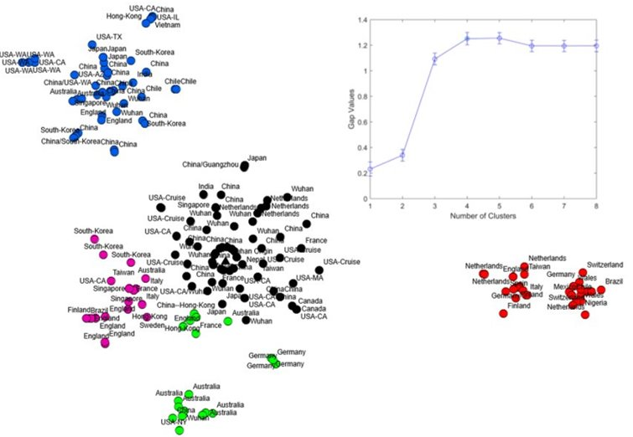
Transmission-based network on genomic compositions of viral sequences
Goal
Infer spatial-temporal transmission routes of SARS-CoV-2 from intial outbreak to pandemic
Methods
Network-based approach tracing the accumulation of mutations in viral genomic variants
Infering transmission networks based on the constructed mutation tree
Clustering: t-SNE based on hamming distance for aligned seqs with a K-means-clustering follow up
Data
N=319, with m=279 SNV's aligned via MUSCLE to reference Genome taken from GISAID

Slide 4
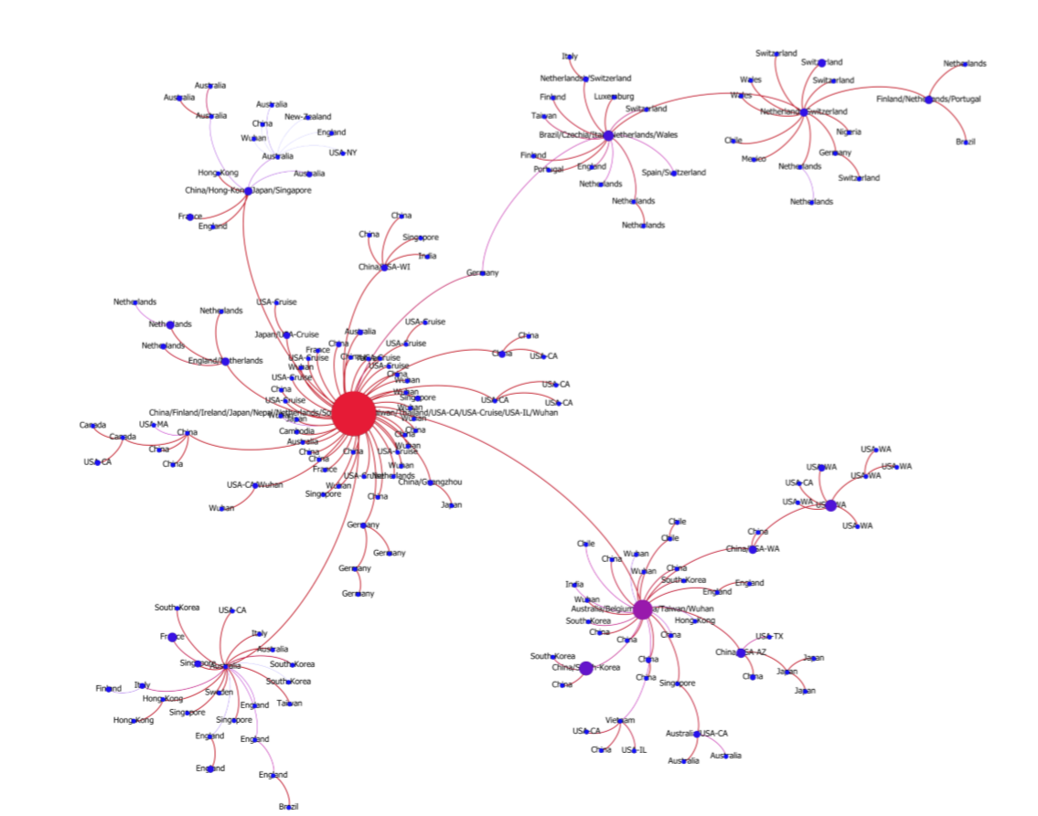
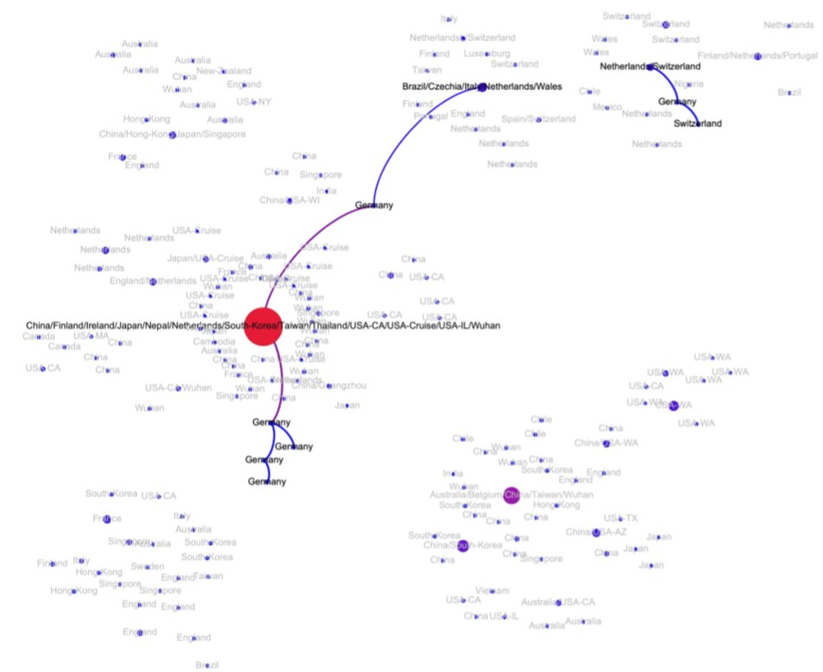
Results

Slide 5

Journal
Medical Virology
Published
23 Feb, 2020

Slide 6
Outline
A Comparative analysis of all the cases reported inside and outside of China
Two appraches:
Exploratory Data Analysis (EDA)
Visual exploratory data analysis approach (V-EDA)
V-EDA has been made to understand the number of different cases reported (confirmed, death, and recovered) in different provinces of China and outside of China
For storing and analyzing the data, the python‐based library of NumPy and pandas. Matplotlib, Plotly , Seaborn and Folium were also used to visualize the highlighted data in an interactive manner.

Slide 7
Data
they used three different sources of dataset provided by John Hopkins University, WHO, CDC, National Health Commission, and DXY.
2019 coronavirus dataset (January‐February 2020), which tracks the spread of 2019‐nCoV
COVID‐19 (nCOV‐19) coronavirus spread dataset, which consists of number of confirmed, death, and recovered reported, and
2019‐nCoV dataset, which handles the day level information on 2019‐nCoV affected cases

Slide 8
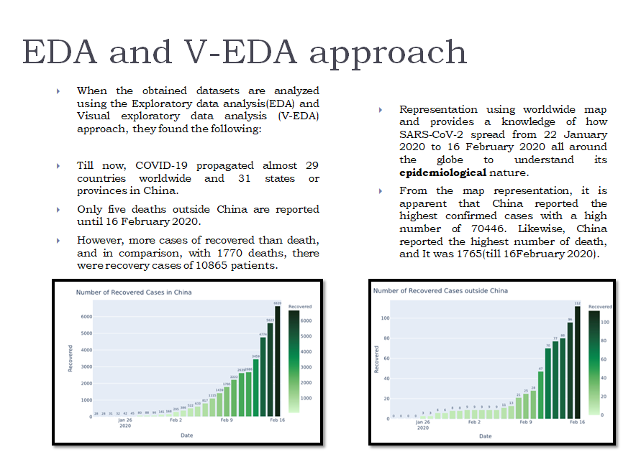

Slide 9

Journal
The Lancet Infectious Diseases
Published
March 23, 2020

Slide 10




Agent-based simulation model (FluTE)
Synthetic Population
Representation of the Singaporean population (at the household and individual level)
Four intervention scenarios
Quarantine
Quarantine + school closure
Quarantine + workplace distancing (50% home office)
Combined interventions
Infectivity profile of SARS-CoV-2
Asymptotic proportion:
7,5% / 22.7% / 30% / 40%
Mean incubation period:
5.3 days
Duration of hospital stay after system onset:
3.5 days
Reproduction number R₀:
1.5 / 2.0 / 2,5
Simulation
80 days
Seeded 100 positive cases randomly
1000 simulations for each scenario and parameter setup
No individual has immunity
Health-care facilities have 3000 beds

Slide 11
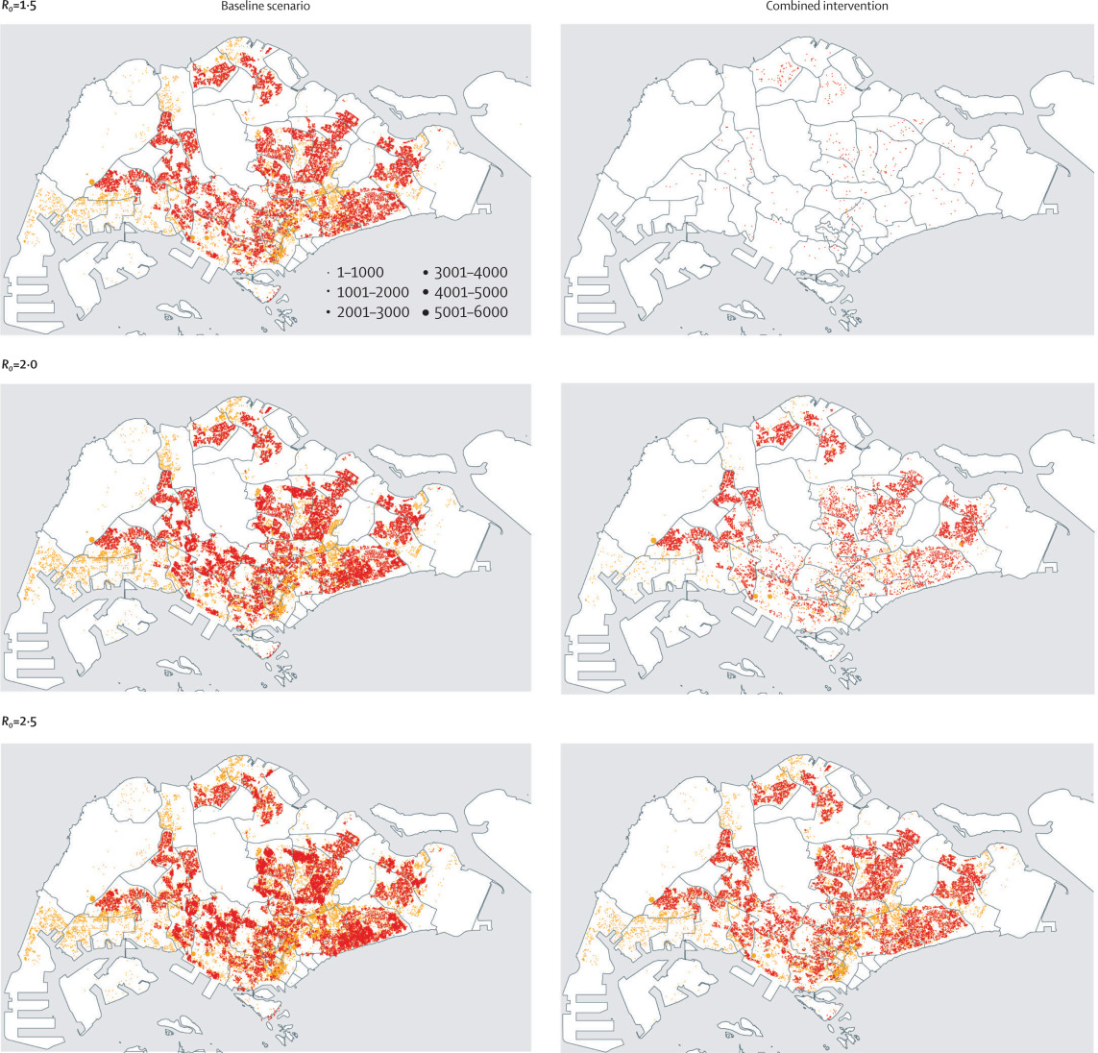

Evaluation
For each scenario and each R₀ value
median cumulative number of infections
Percentage of entire population
+ IQR (25% and 75%)
Reducing (%) for each scenario compared to the baseline scenario

Slide 12

Journal
Science
Published
April 24, 2020

Slide 13
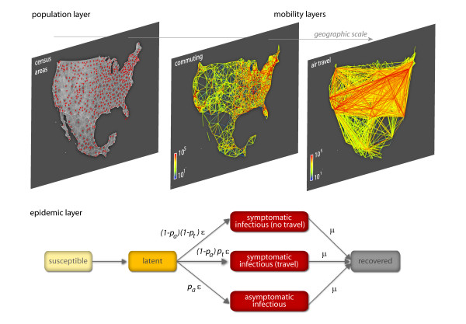
Global epidemic and mobility model (GLEAM)
Model Backbone
World is divided into more than 3200 subsections which are connected by the recorded flux of travelers between them
Within each subsection individuals occupy one of four states at one time and can progress into another one
Data until 23 Jan 2020 used to calibrate model
Scenarios for China
Travel reduction: 0%, 40%, 90%
Reproduction number R₀: 2,4(recorded value for Wuhan in Jan2020), 1.0, 0.75, 0.5
Data
WHO
OAG and IATA databases (airplanes)
Statistic offices collected data around five continents (ground mobility)
Simulation
Each individual within subsections is treaded independently (no family or job relations)
Each individual has a possibility assigned to travel to another location based on recorded data

Slide 14
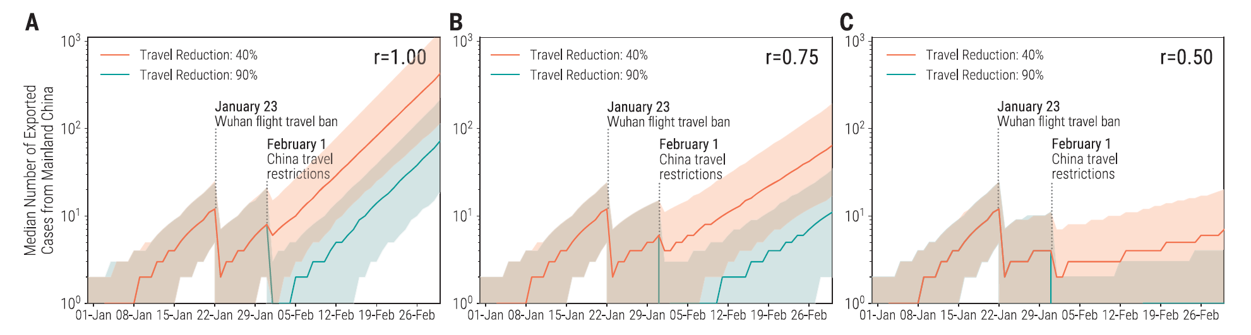
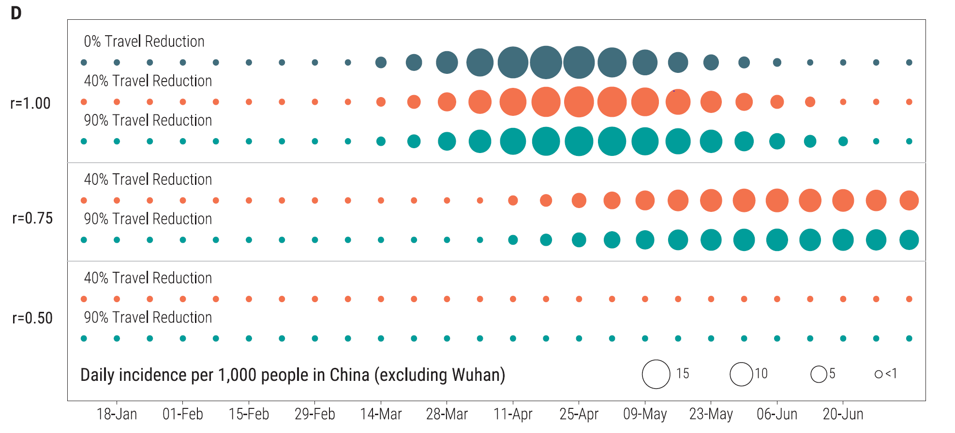
Results
The modeling study shows that additional travel limitations (up to 90% of traffic) have only a modest effect unless paired with public health interventions and behavioral changes that can facilitate a considerable reduction in disease transmissibility
Nonetheless the travel restrictions delayed the outbreak in China for several days and on the international scale for 2-3 weeks

Slide 15
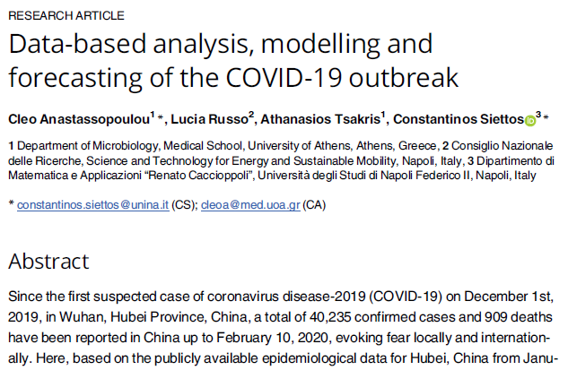
Journal
PLOS ONE
Published
March 31, 2020

Slide 16
Susceptible-Infectious-Recovered-Dead model (SIDR)
Model Backbone​
​ predict evolution of the outbreak at the epicenter three weeks ahead, i.e. until February 29, 2020
S(t) the number of susceptible; I(t) the number of infected; R(t) the number of recovered; D(t) the number of dead persons respectively at time t in the population of size N
data from January 11 to February 10, 2020 used to calibrate model
Scenarios
Scenario | the number of confirmed infected cases | the number of recovered | the number of deaths
1 | unchanged | unchanged | Unchanged
2 | 20times | 40 times | unchanged
Data
epidemiological data for Hubei, China available in the public domain
WHO, CDC, ECDC, NHC, DXY
Simulation
•estimations of the basic reproduction number (R_0)
•the per day infection mortality (γ ̂)
•recovery rates (β ̂)

Slide 17
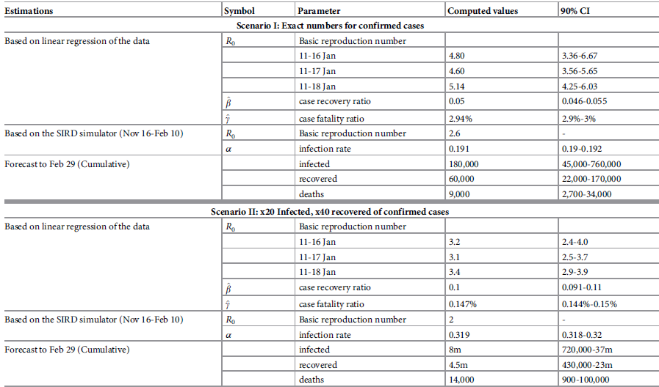
Results
according to the official data released on the 29th of February, the cumulative number of confirmed infected cases in Hubei was 67,000, that of recovered was 31,300 and the death toll was 2,800. These numbers are within the lower bounds of forecasts from the 10th of February that are based on Scenario I

